Slide 1
Rock-Paper-Scissors Game
A Fun Python CLI Game with Bot Banter
Project by Vinay Sai Pavan Banduchode
MicroIT internship project
May,2025

Slide 2

Introduction
This presentation explores the development of a Python-based Rock-Paper-Scissors game featuring interactive bot responses and user engagement.

Slide 3
01
Project Overview

Slide 4

Key Features
The game incorporates classic Rock-Paper-Scissors logic, engaging bot interactions with randomized responses, and a user-friendly Command Line Interface (CLI) design. Features include score tracking to enhance competitiveness, allowing players to keep track of their wins and losses.

Slide 5

Technical Stack
The game is built using Python 3.x, leveraging the random module to enable the bot's choice-making. It utilizes a dictionary-based approach to define win conditions, ensuring a structured and straightforward logic flow.

Slide 6
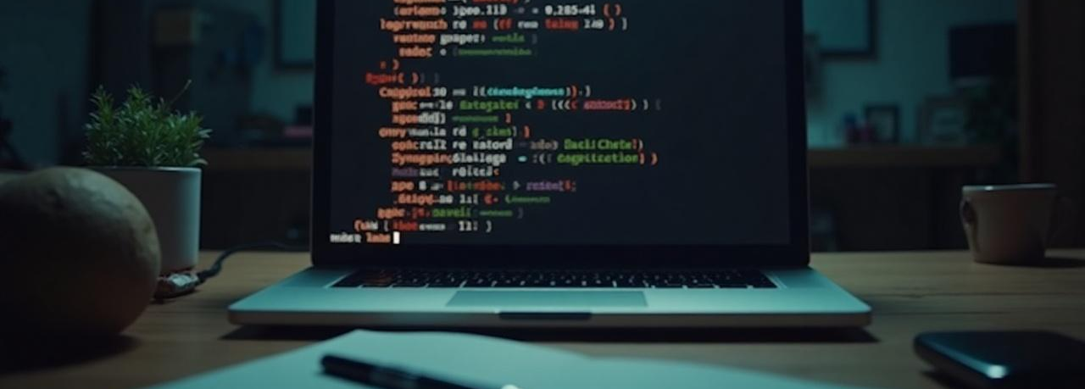
User Interface Design
The user interface of the Rock-Paper-Scissors game is designed to be intuitive and engaging, leveraging a Command Line Interface (CLI). Clear prompts guide users through their gameplay experience, with visually distinct icons representing each option: rock, paper, and scissors. This enhances user interaction and ensures an enjoyable experience.

Slide 7
02
Game Logic

Slide 8

Bot Decision Mechanism
The bot's decision-making process is governed by the random module in Python, which allows it to select responses unpredictably. This adds an element of surprise to the game and mimics real-life unpredictability in a RPS match. The bot can provide humorous responses, enriching the user experience and making gameplay more entertaining.

Slide 9

Win Conditions
Win conditions are clearly defined within the game logic through a dictionary that maps each option to its corresponding winning move. For instance, rock defeats scissors, scissors defeat paper, and paper defeats rock. Implementing these rules ensures fair play while allowing users to understand and anticipate outcomes.

Slide 10

Error Handling
Robust error handling is implemented to validate user input, ensuring that only valid choices (rock, paper, or scissors) are accepted. Should a user input an invalid response, the game gracefully prompts them to try again, which maintains the flow of the game and minimizes frustration.

Slide 11

Conclusions
The Rock-Paper-Scissors game effectively combines classic gameplay with modern programming elements, showcasing the Python language's versatility. Through engaging bot interactions and thoughtful design, the game provides both entertainment and educational value.

Slide 12
Thank you!
Do you have any questions?

